Slide 1

Live Coding a DDD model
developing an example business case

Slide 2
Live Coding
Show step by step the construction of one business case
The goal is to see the different levels of abstraction of the solution (coding and architecture)
Through the example we are gonna use and explain some of the most relevant DDD tactical patterns.

Slide 3

Hexagonal architecture
It makes the application domain model central to the system and isolates its definition from the program's technical infrastructure
The application domain model includes interfaces (ports) that define its relationships with the outside world in terms of application domain concepts
All input and output reaches/leaves the app through a port

Slide 4
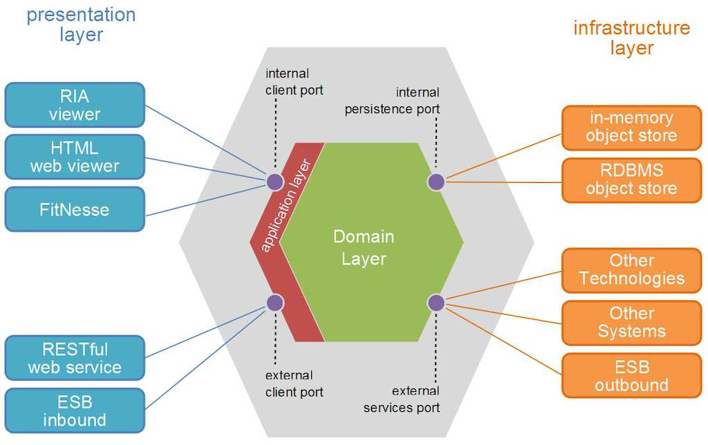

Slide 5
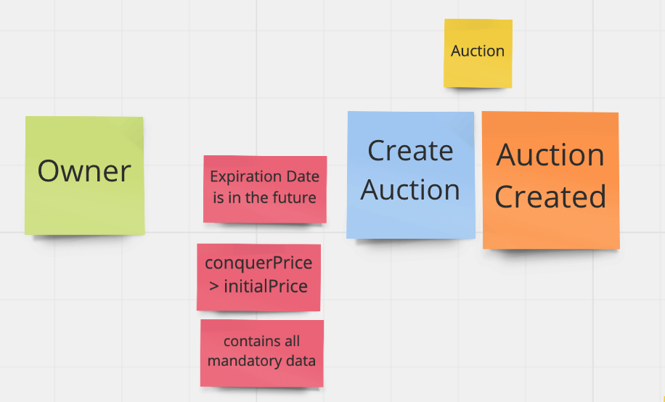
Implementing createAuction

Slide 6
Let’s write some code!!

Slide 7
Begin with the test
CreateAuctionActionShould

Slide 8
Command
CreateAuctionActionShould
CreateAuctionCommand

Slide 9
Action
CreateAuctionActionShould
CreateAuctionCommand
CreateAuctionAction

Slide 10
Repository
CreateAuctionActionShould
CreateAuctionCommand
CreateAuctionAction
Auction Repository

Slide 11
Agregado
CreateAuctionActionShould
CreateAuctionCommand
CreateAuctionAction
Auction
Auction Repository

Slide 12
Value object
CreateAuctionActionShould
CreateAuctionCommand
Money
CreateAuctionAction
Auction
Auction Repository

Slide 13
Policies or Invariants
CreateAuctionActionShould
CreateAuctionCommand
Money
CreateAuctionAction
Auction
Auction Repository

Slide 14
HTTP Request
Routing
AuctionRepositoryInMemory
AuctionAPI
AuctionRepositorySql
Database

Slide 15
CreateAuctionApiShould
Routing
AuctionRepositoryInMemory
AuctionAPI

Slide 16
Proposed Exercise
We are going to implement the action that allows the users make bids in an auction. Consider the scenarios:
given an auction with initial price 10
when the bidder make a bid of 15
then the new top bid of the auction is 15
given an auction with a initial price of 10
when the bidder make a bid of 9
then the bid is not accepted and the current top auction does not change

Slide 17
Some tips...
Start with the test for the OverbidAuctionAction
create a test for the happy path first
for the “then” part you need a captor similar to the CreateAuctionActionShould test
for the “given” part of the test you need:
to create a new method in the AuctionRepository to retrieve an existing auction
stub this method in the test to return an Auction
var auction = …. // create the given auction
when(auctionRepository.retrieveById(auction.id)).thenReturn(auction);

Slide 18
This is not a layered architecture?
Philosophical: The model is the center not one more layer
Technical: Dependency Inversion
UI
Model
Model
UI
Database
Database

